Slide 1
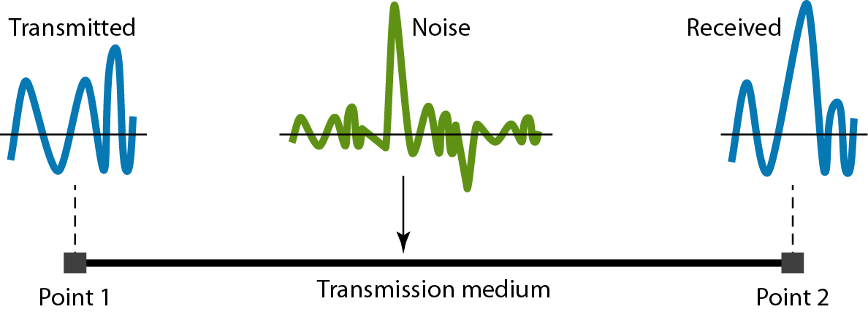
Noise
3.‹#›
Notes:
‹#›

Slide 2
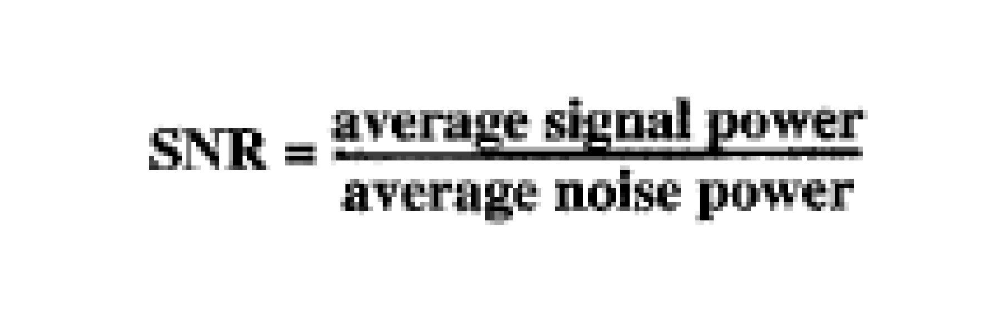
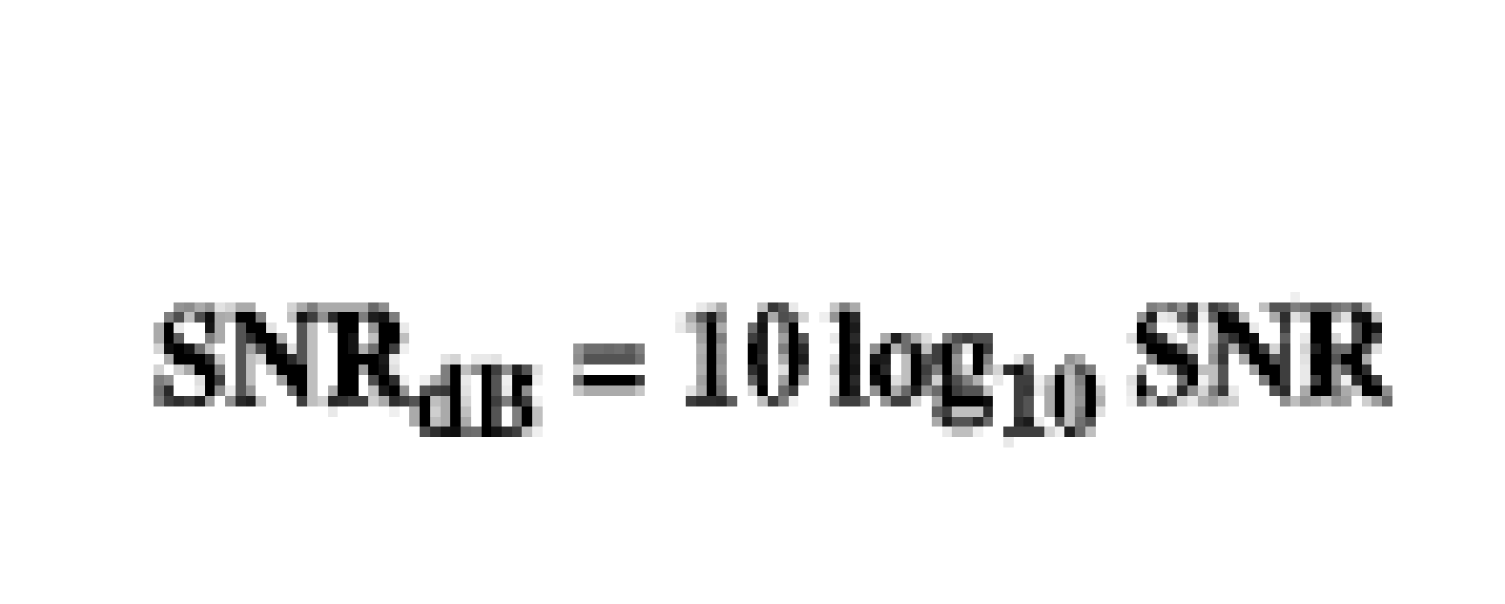
Noise
3.‹#›
Notes:
‹#›

Slide 3
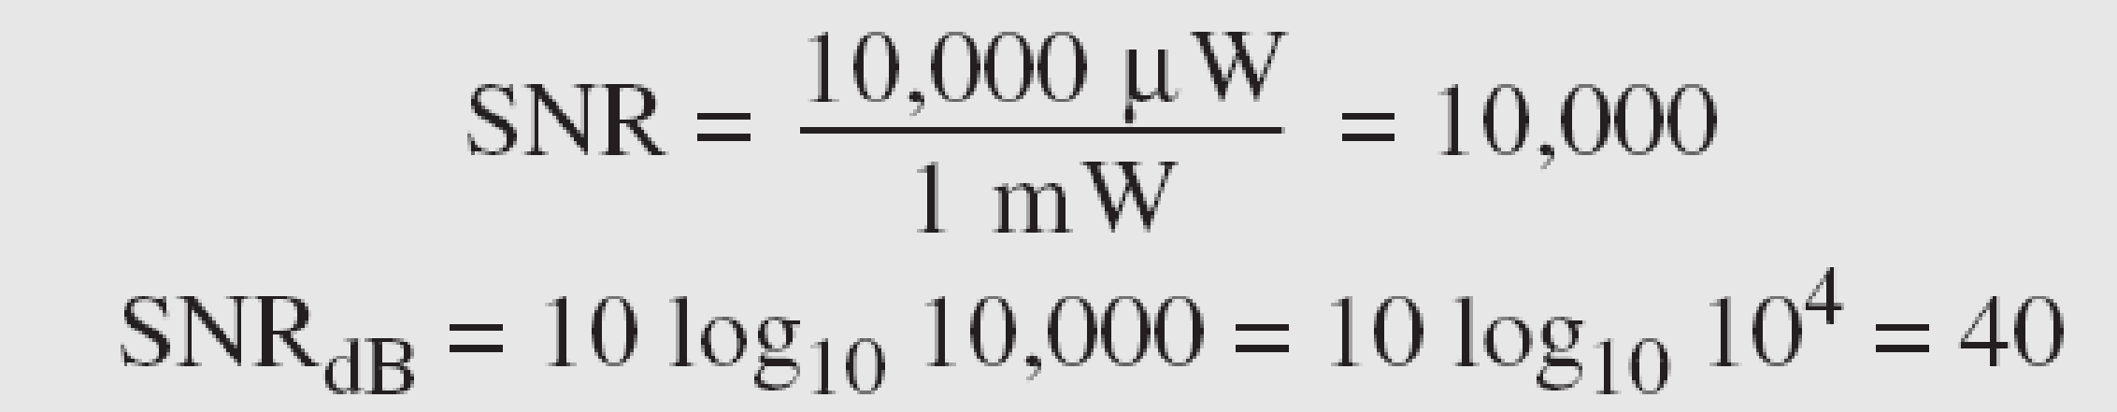
Example 3.31
The power of a signal is 10 mW and the power of the noise is 1 μW; what are the values of SNR and SNR_{dB} ?
Solution
The values of SNR and SNR_{dB} can be calculated as follows:
3.‹#›
Notes:
‹#›

Slide 4
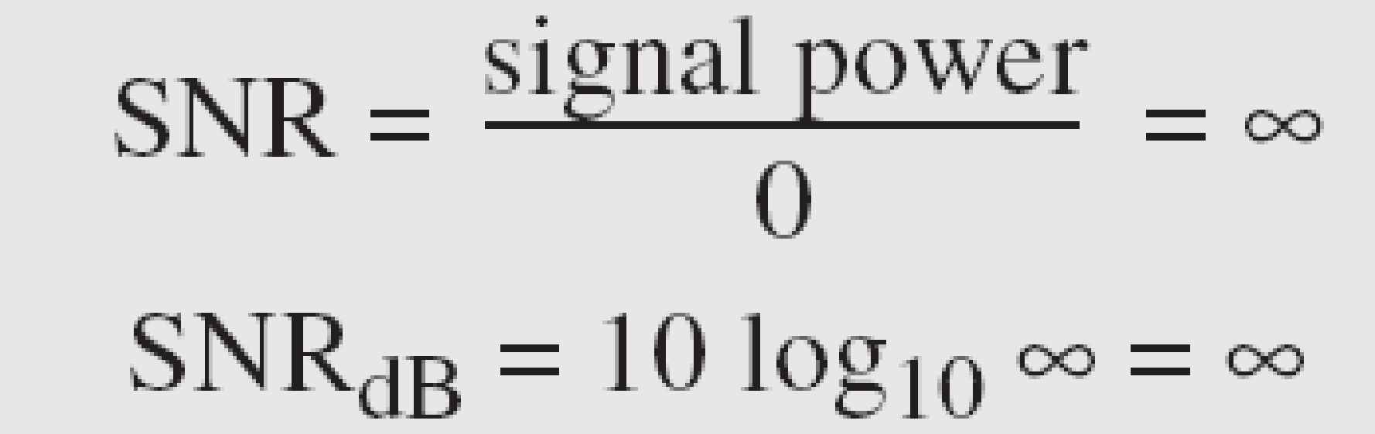
Example 3.32
The values of SNR and SNR_{dB} for a noiseless channel are
We can never achieve this ratio in real life; it is an ideal.
3.‹#›
Notes:
‹#›

Slide 5
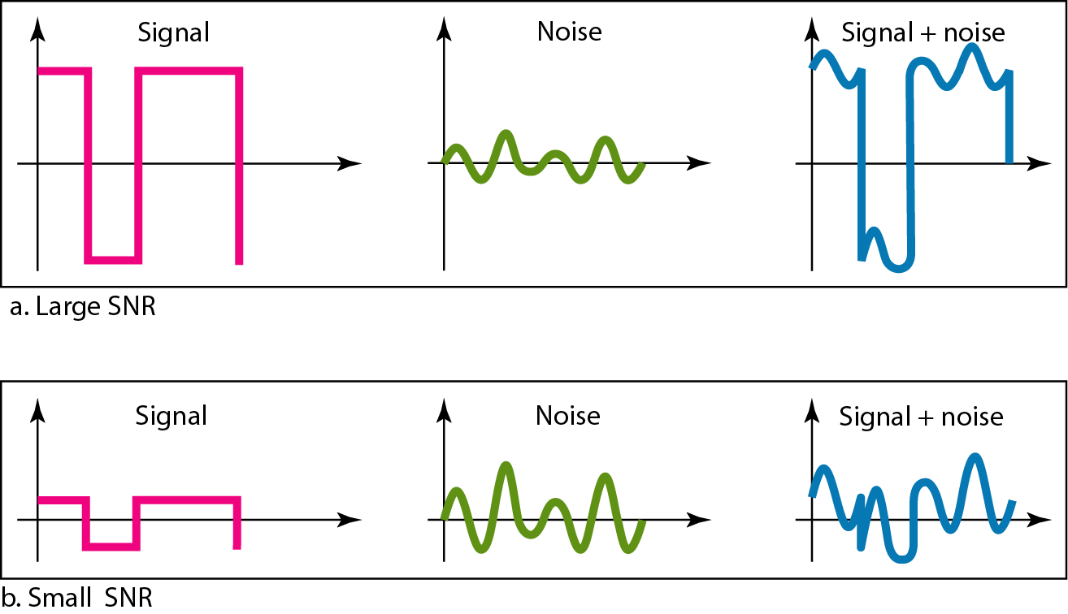
Figure 3.30 Two cases of SNR: a high SNR and a low SNR
3.‹#›
Notes:
‹#›

Slide 6
3-5 DATA RATE LIMITS
A very important consideration in data communications is how fast we can send data, in bits per second, over a channel. Data rate depends on three factors:
1. The bandwidth available
2. The level of the signals we use
3. The quality of the channel (the level of noise)
Topics discussed in this section:
Noiseless Channel: Nyquist Bit Rate
Noisy Channel: Shannon Capacity
Using Both Limits
3.‹#›
Notes:
‹#›

Slide 7

3-5 DATA RATE LIMITS
Noiseless Channel: Nyquist Bit Rate
-Theoretical maximum bit rate
L=number of signal levels used to represent data
3.‹#›
Notes:
‹#›

Slide 8

Note
Increasing the levels of a signal may reduce the reliability of the system.
3.‹#›
Notes:
‹#›

Slide 9
Example 3.34
Consider a noiseless channel with a bandwidth of 3000 Hz transmitting a signal with two signal levels. The maximum bit rate can be calculated as
3.‹#›
Notes:
‹#›

Slide 10
Example 3.35
Consider the same noiseless channel transmitting a signal with four signal levels (for each level, we send 2 bits). The maximum bit rate can be calculated as
3.‹#›
Notes:
‹#›

Slide 11

3-5 DATA RATE LIMITS
Noisy Channel: Shannon Capacity
Theoretical data rate for a noisy channel
3.‹#›
Notes:
‹#›

Slide 12
Example 3.37
Consider an extremely noisy channel in which the value of the signal-to-noise ratio is almost zero. In other words, the noise is so strong that the signal is faint. For this channel the capacity C is calculated as
This means that the capacity of this channel is zero regardless of the bandwidth. In other words, we cannot receive any data through this channel.
3.‹#›
Notes:
‹#›

Slide 13
Example 3.38
We can calculate the theoretical highest bit rate of a regular telephone line. A telephone line normally has a bandwidth of 3000. The signal-to-noise ratio is usually 3162. For this channel the capacity is calculated as
This means that the highest bit rate for a telephone line is 34.860 kbps. If we want to send data faster than this, we can either increase the bandwidth of the line or improve the signal-to-noise ratio.
3.‹#›
Notes:
‹#›

Slide 14

Example 3.40
For practical purposes, when the SNR is very high, we can assume that SNR + 1 is almost the same as SNR. In these cases, the theoretical channel capacity can be simplified to
3.‹#›
Notes:
‹#›

Slide 15
Using both levels
We have a channel with a 1-MHz bandwidth. The SNR for this channel is 63. What are the appropriate bit rate and signal level?
Solution
First, we use the Shannon formula to find the upper limit.
3.‹#›
Notes:
‹#›

Slide 16
Example 3.41 (continued)
The Shannon formula gives us 6 Mbps, the upper limit. For better performance we choose something lower, 4 Mbps, for example. Then we use the Nyquist formula to find the number of signal levels.
3.‹#›
Notes:
‹#›

Slide 17
Note
The Shannon capacity gives us the upper limit; the Nyquist formula tells us how many signal levels we need.
3.‹#›
Notes:
‹#›

Slide 18
3-6 PERFORMANCE
One important issue in networking is the performance of the network—how good is it? In this section, we introduce terms that we need for future.
Topics discussed in this section:
Bandwidth
Throughput
Latency (Delay)
Bandwidth-Delay Product
3.‹#›
Notes:
‹#›

Slide 19
Note
In networking, we use the term bandwidth in two contexts.
❏ The first, bandwidth in hertz, refers to
the range of frequencies in a
composite signal or the range of
frequencies that a channel can pass.
❏ The second, bandwidth in bits per
second, refers to the speed of bit
transmission in a channel or link.
3.‹#›
Notes:
‹#›

Slide 20
Example 3.42
The bandwidth of a subscriber line is 4 kHz for voice or data. The bandwidth of this line for data transmission
can be up to 56,000 bps using a sophisticated modem to change the digital signal to analog.
3.‹#›
Notes:
‹#›

Slide 21

Example 3.44
Throughput and bandwidth are different
A network with bandwidth of 10 Mbps can pass only an average of 12,000 frames per minute with each frame carrying an average of 10,000 bits. What is the throughput of this network?
Solution
We can calculate the throughput as
The throughput is almost one-fifth of the bandwidth in this case.
3.‹#›
Notes:
‹#›

Slide 22
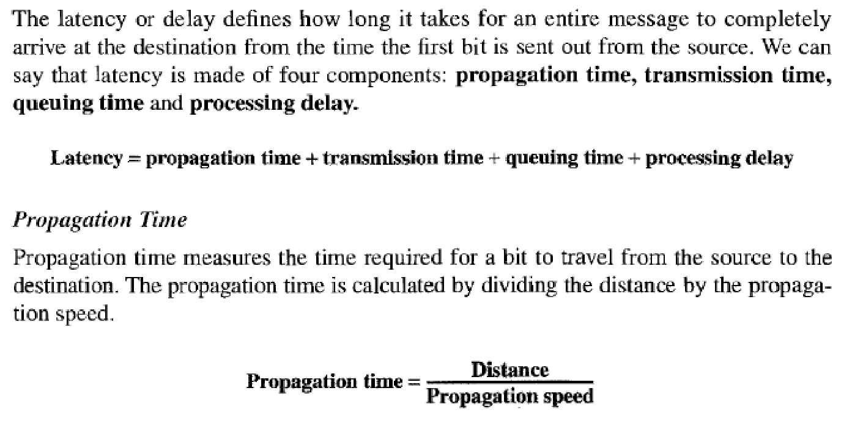
Latency
3.‹#›
Notes:
‹#›

Slide 23

Example 3.45
What is the propagation time if the distance between the two points is 12,000 km? Assume the propagation speed to be 2.4 × 108 m/s in cable.
Solution
We can calculate the propagation time as
The example shows that a bit can go over the Atlantic Ocean in only 50 ms if there is a direct cable between the source and the destination.
3.‹#›
Notes:
‹#›

Slide 24
Example 3.46
What are the propagation time and the transmission time for a 2.5-kbyte message (an e-mail) if the bandwidth of the network is 1 Gbps? Assume that the distance between the sender and the receiver is 12,000 km and that light travels at 2.4 × 108 m/s.
Solution
We can calculate the propagation and transmission time as shown on the next slide:
3.‹#›
Notes:
‹#›

Slide 25
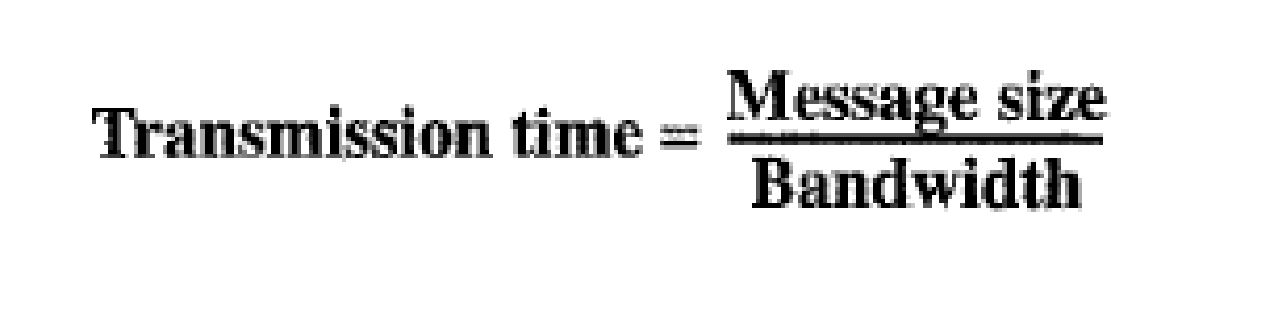
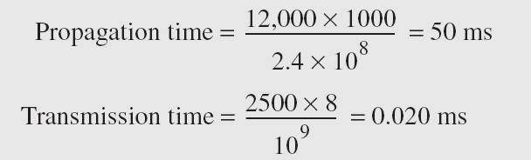
Example 3.46 (continued)
Note that in this case, because the message is short and the bandwidth is high, the dominant factor is the propagation time, not the transmission time. The transmission time can be ignored.
3.‹#›
Notes:
‹#›

Slide 26
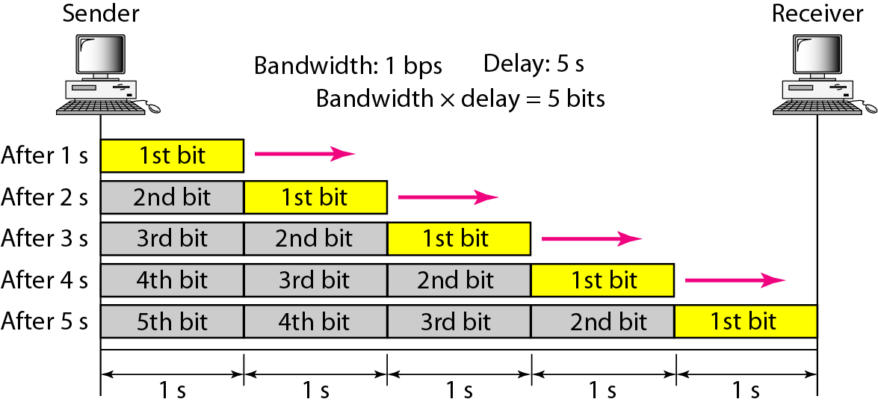
Figure 3.31 Filling the link with bits for case 1
3.‹#›
Notes:
‹#›

Slide 27
Example 3.48
We can think about the link between two points as a pipe. The cross section of the pipe represents the bandwidth, and the length of the pipe represents the delay. We can say the volume of the pipe defines the bandwidth-delay product, as shown in Figure 3.33.
3.‹#›
Notes:
‹#›

Slide 28
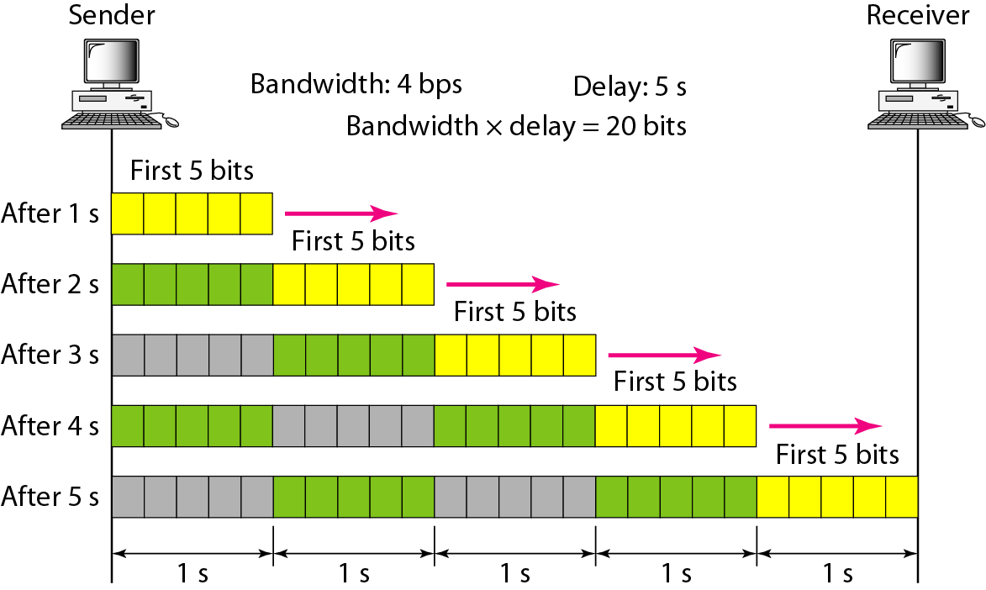
Figure 3.32 Filling the link with bits in case 2
3.‹#›
Notes:
‹#›

Slide 29
Note
The bandwidth-delay product defines the number of bits that can fill the link.
3.‹#›
Notes:
‹#›

Slide 30

Figure 3.33 Concept of bandwidth-delay product
3.‹#›
Notes:
‹#›

Slide 31
Jitter
3.‹#›

Slide 32
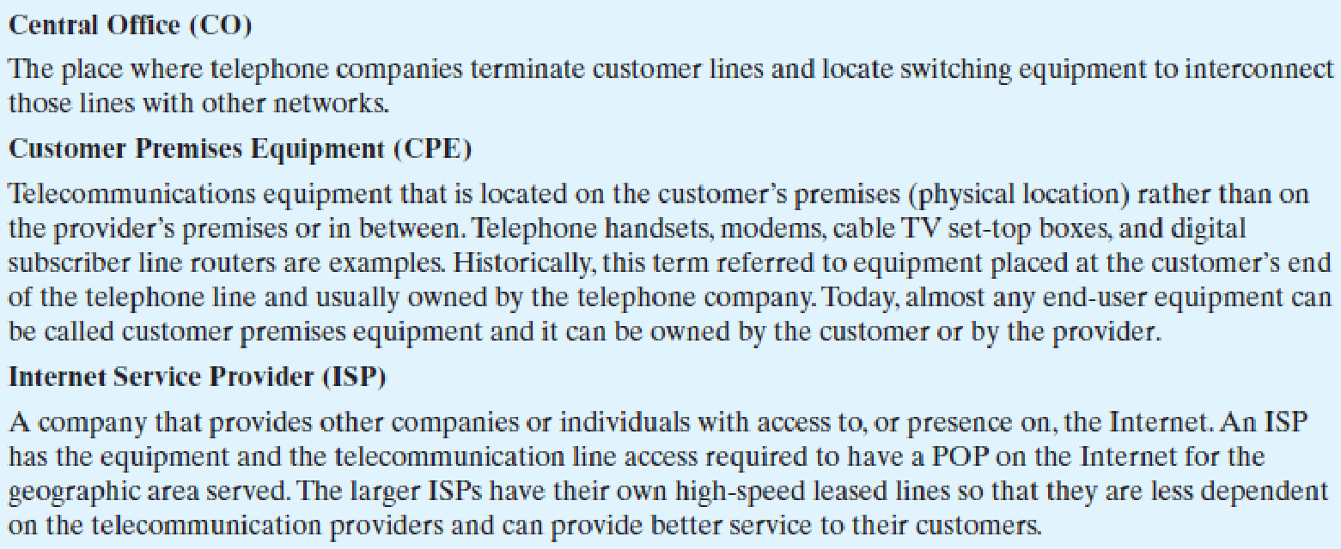
Internet Terminology
3.‹#›

Slide 33
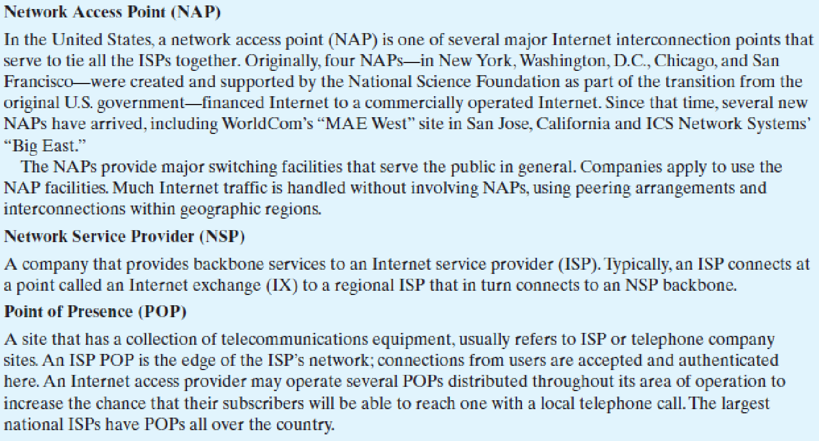
Internet Terminology
3.‹#›

Slide 34
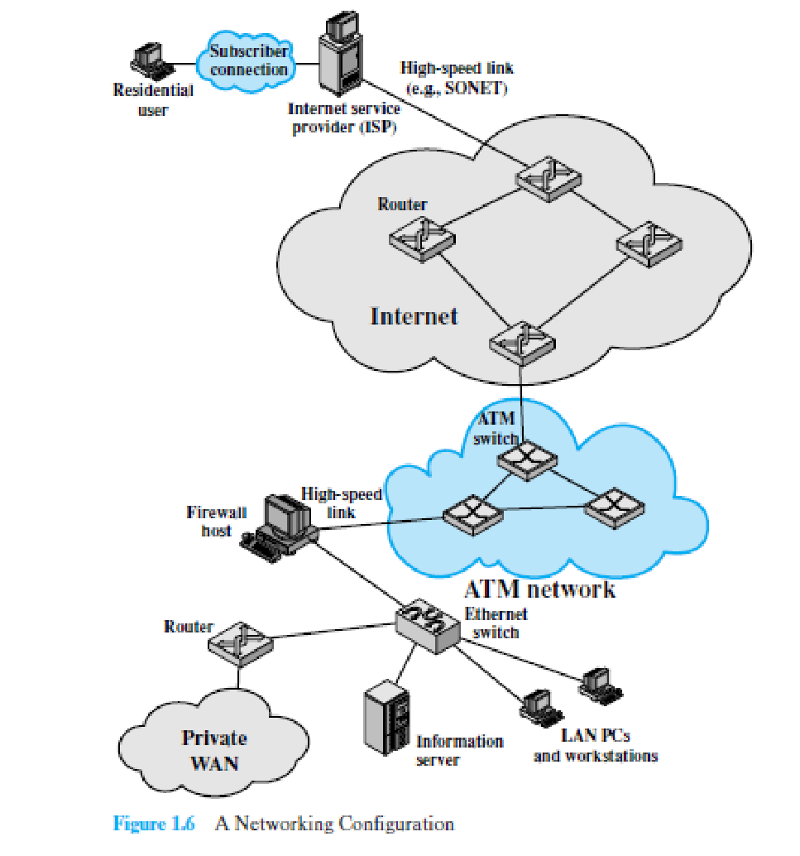
3.‹#›

